Slide 1
Building an Online Food Delivery System with Django
Python Django project
Prepared by DHEERAJ KUMAR,
Roll No.=2100320100064.
Branch and sec= B-tech. and CSE-A.
Project guide= Mr. Devendra Kumar Mishra sir.

Slide 2
Problem introduction
Whenever we visit any restaurant or an food shop then we generally have an issue of waiting queue that most of us are not used to entertain and, Nowadays generally customers prefer their food to be delivered online at their home safely.
Through our system the customers would be easily able to place orders as they like using the online meal ordering system, which sets up a food menu online. Online shoppers can also simply track their orders.

Slide 3
Project objective.
To learn python.
To learn Django and html.
To develop a system that will surely satisfied the customer service.
To design a system able to accommodate huge amount of orders at a time.
To evaluate its performance and acceptability in terms of security, user-friendliness, accuracy and reliability
To improve the communication between the client and the server and minimize the time of ordering.

Slide 4
Why Django?
Django is a high-level, open-source web framework for building web applications quickly and efficiently. There are several benefits associated with using Django for web development.
Rapid Development: Django facilitates quick and efficient development with its DRY (Don't Repeat Yourself) principle.
Security: Offers built-in security features and encourages best practices, protecting against common web vulnerabilities.
Versatility: Suitable for various web development projects, from small applications to complex systems.

Slide 5
Motivation
Consumer Convenience:
Enable customers to order food from the comfort of their homes.
Save time and effort for busy individuals and working professionals.
Market Demand:
Respond to the growing trend of online food ordering.
Tap into a market with a high demand for convenient dining options.

Slide 6
Increased Revenue for Restaurants:
Expand the customer base for restaurants.
Boost sales and revenue without the need for additional physical locations.
Technology Advancements:
Leverage user-friendly websites and mobile apps.
Benefit from advancements that simplify the setup and operation of online food delivery systems

Slide 7
System components
Front-end web or mobile application: This is the interface customers use to generate menus, browse menus, place orders, and track delivery status.
Backend server or Services: This component handles requests from the front end, communicates with the database, and coordinates with delivery partners.
Database: This stores information about menus, orders, customers, and delivery partners.
API Gateway: This is responsible for request routing, composition, and protocol translation, among other things, between an application and a set of microservices.

Slide 8
Messaging Queue: An asynchronous communication between systems that allows multiple systems to send and receive messages reliably and efficiently without needing to be constantly connected.
Notification Service: To send notifications to users, typically through email or push notifications.
Tracking Engine: This will constantly watch for changes in the DB, update the elastic search index, and notify the messaging queue.

Slide 9
Deployment
All the services, backend applications, and APIs can be packaged in Docker containers and deployed and scaled using a Docker orchestrator such as Docker Swarm, Mesos, or Kubernetes.
This allows for easy management and scaling of the applications. We can use AWS services such as ECS, EKS, or Fargate to manage the deployment of these containerized applications. This allows for easy integration with other AWS services, automatic scaling, and high availability of the applications.

Slide 10
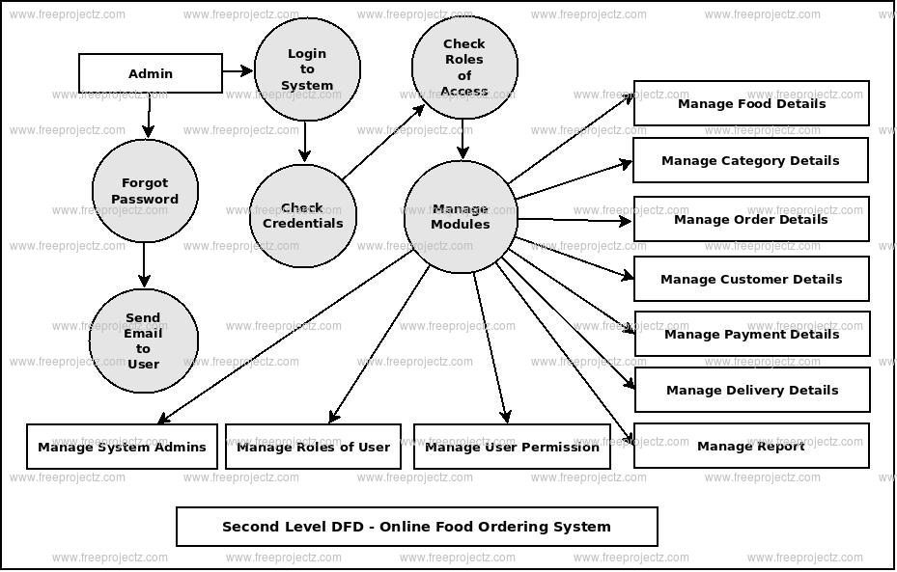
ER Diagram

Slide 11
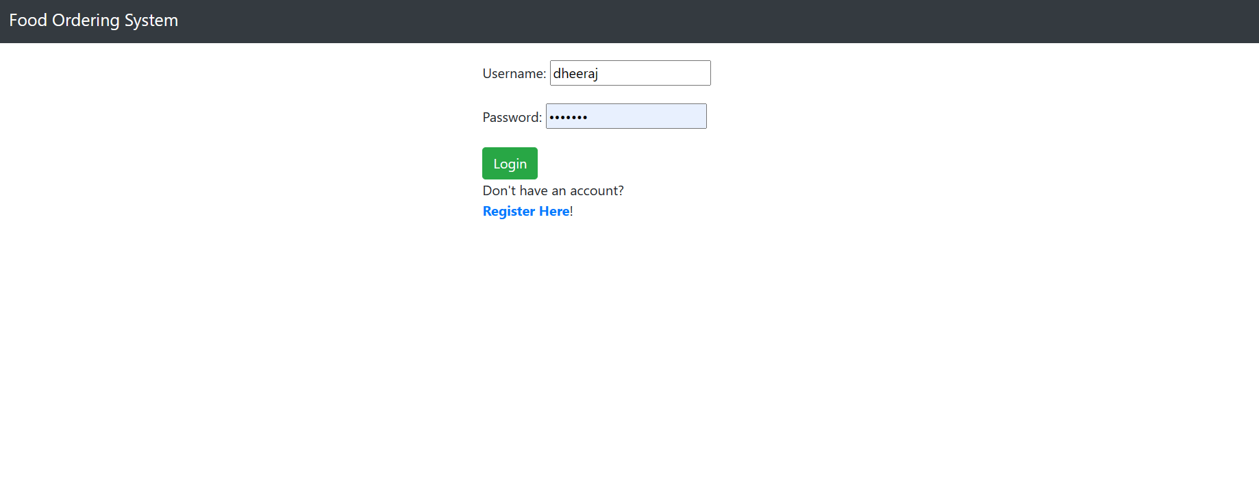
Work process

Slide 12
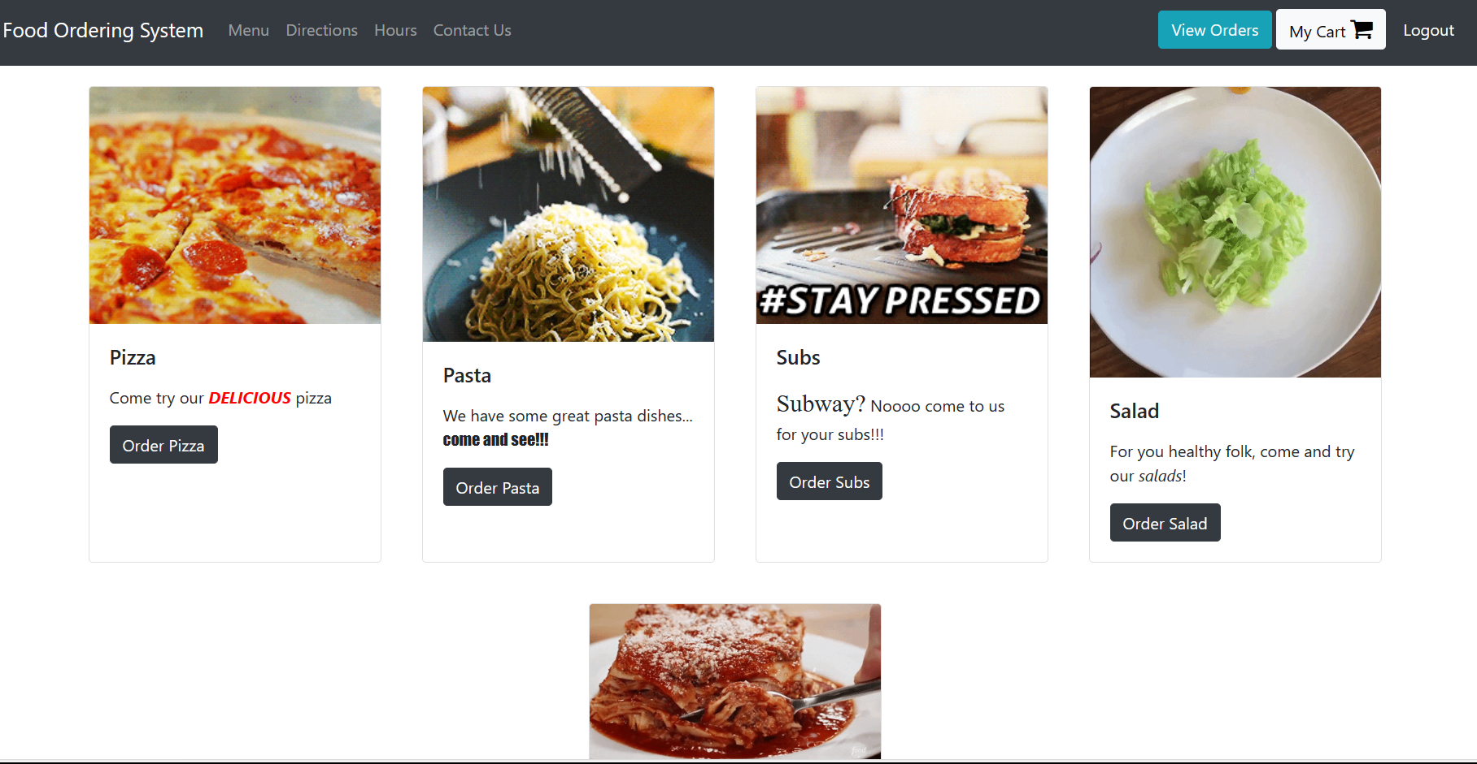
Menu page

Slide 13
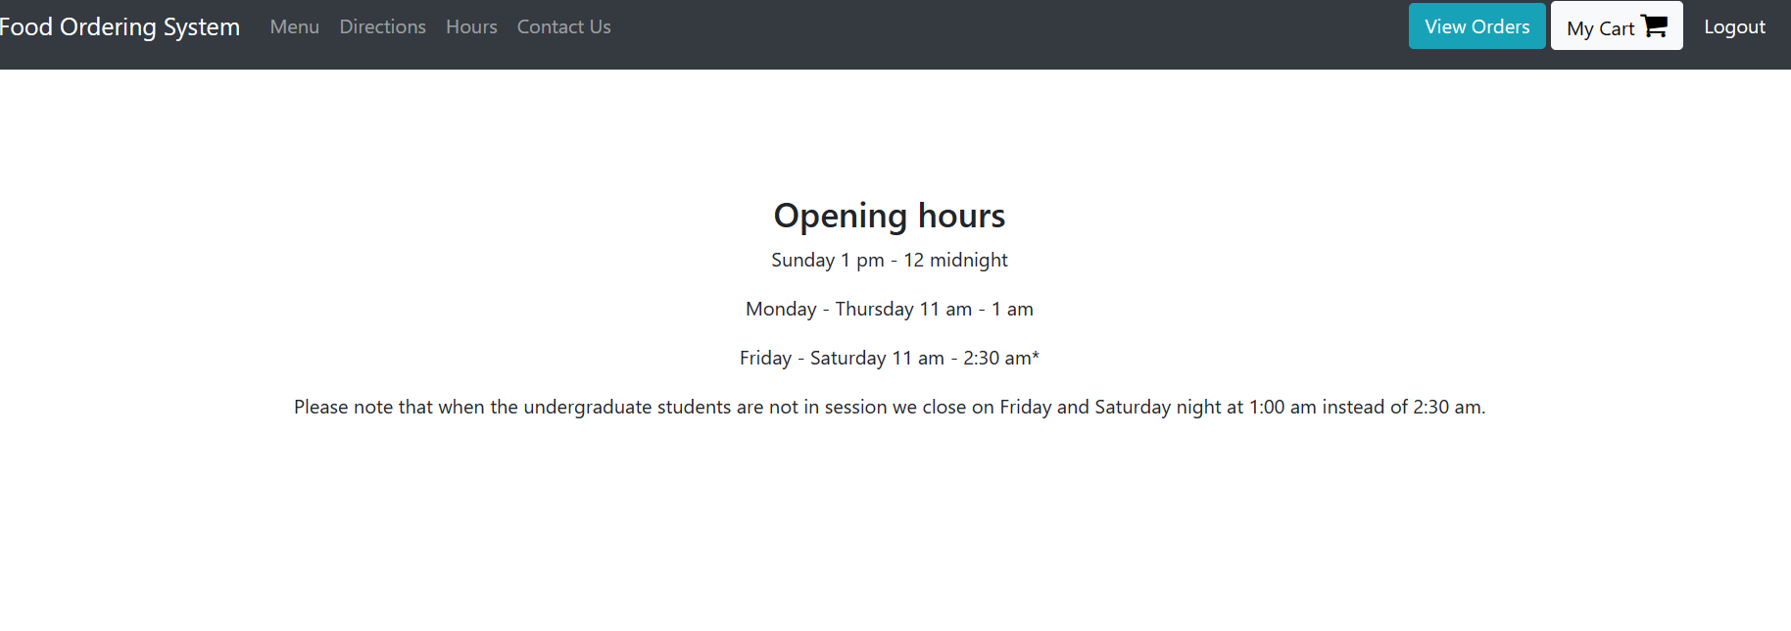
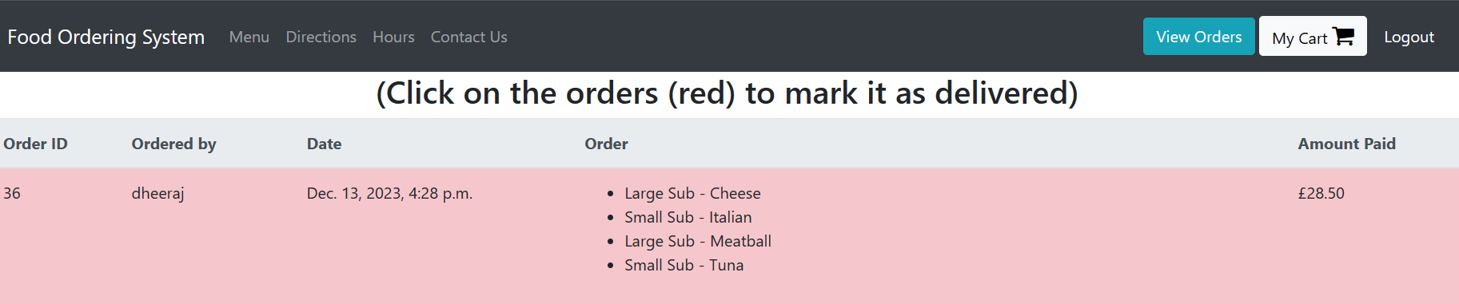

Slide 14
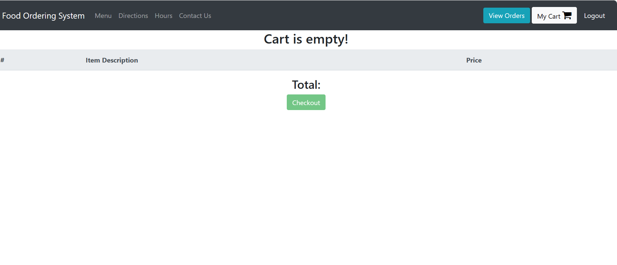
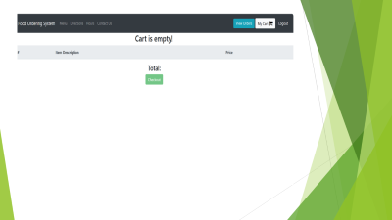

Slide 15
Reference
Codeastro and youtube.

Slide 16
Thank you

